Slide 1
Emotion Extraction through Speech
By:-
Somesh Bachani 18SCSE1180018

Slide 2
Abstract
Emotion Recognition using Mel-frequency cepstral coefficients and Dynamic time warping is used to determine the emotion of the speaker from his voice. The speech signal given by the speaker is compared with the database which consists of various sentences which define the various emotions of the language.

Slide 3
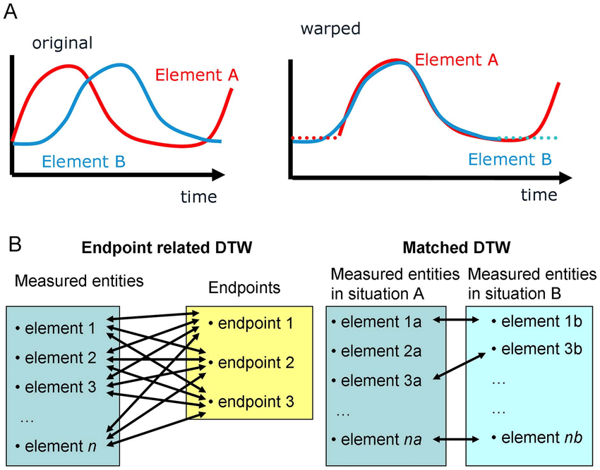
Methodology:
In order to determine the emotion of the received speech signal, we have to obtain various features like energy, power spectral density (PSD) etc. of the signal and compare it with the recorded database. We are achieving this using MFCC. Also, in order to eliminate the difference between the database and the input signal, we use a method called Time Warping.

Slide 4
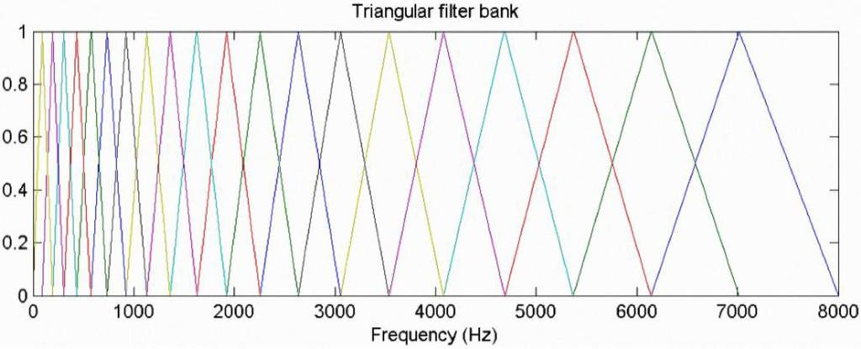
MFCC(Mel-frequency cepstral coefficients)
We Use MFCC for a cepstral representation of the audio clip (a nonlinear "spectrum-of-a-spectrum").a signal goes through a pre-emphasis filter; then gets sliced into (overlapping) frames and a window function is applied to each frame; afterwards, we do a Fourier transform on each frame (or more specifically a Short-Time Fourier Transform) and calculate the power spectrum; and subsequently compute the filter banks. To obtain MFCCs, a Discrete Cosine Transform (DCT) is applied to the filter banks retaining a number of the resulting coefficients while the rest are discarded. A final step is mean normalization.

Slide 5
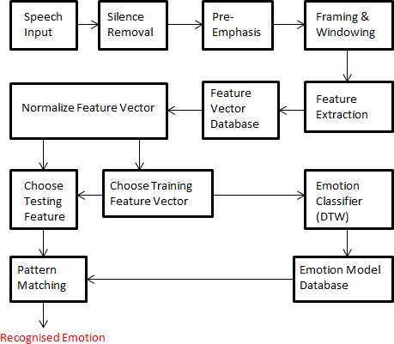
Architecture Diagram
Here we see the proposed model for project. The project comprises of :-
Database with acted speech
Training & testing phase comprising of :-
  Signal Processing
  Feature calculation
  Classification

Slide 6
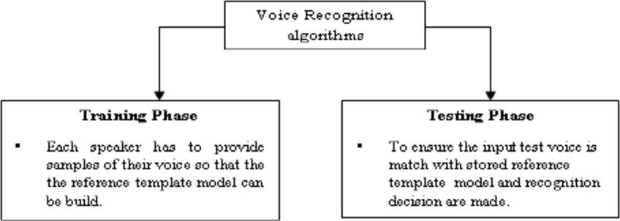
Algorithm for Voice recognition
A voice analysis is done after taking an input through a microphone from a user. The design of the system involves manipulation of the input audio signal. At different levels, different operations are performed on the input signal such as Pre-emphasis, Framing, Windowing, Mel Cepstrum analysis and Recognition (Matching) of the spoken word. The voice algorithms consist of two distinguished phases. The first one is training sessions, whilst the second one is referred to as the operation session or testing phase.

Slide 7
Database Details
The database used Surrey Audio-Visual Expresses Emotion (SAVEE) Database.
The SAVEE database was recorded from four native English male speakers. Emotion has been described psychologically in discrete categories: anger, disgust, fear, happiness, sadness and surprise.We added neutral to provide recordings of 7 emotion categories. The text material consisted of 15 TIMIT sentences per emotion: 3 common, 2 emotion-specific and 10 generic sentences that were different for each emotion and phonetically-balanced. The 3 common and 2× 6 = 12 emotion-specific sentences were recorded as neutral to give 30 neutral sentences. This resulted in a total of 120 utterances per speaker.

Slide 8
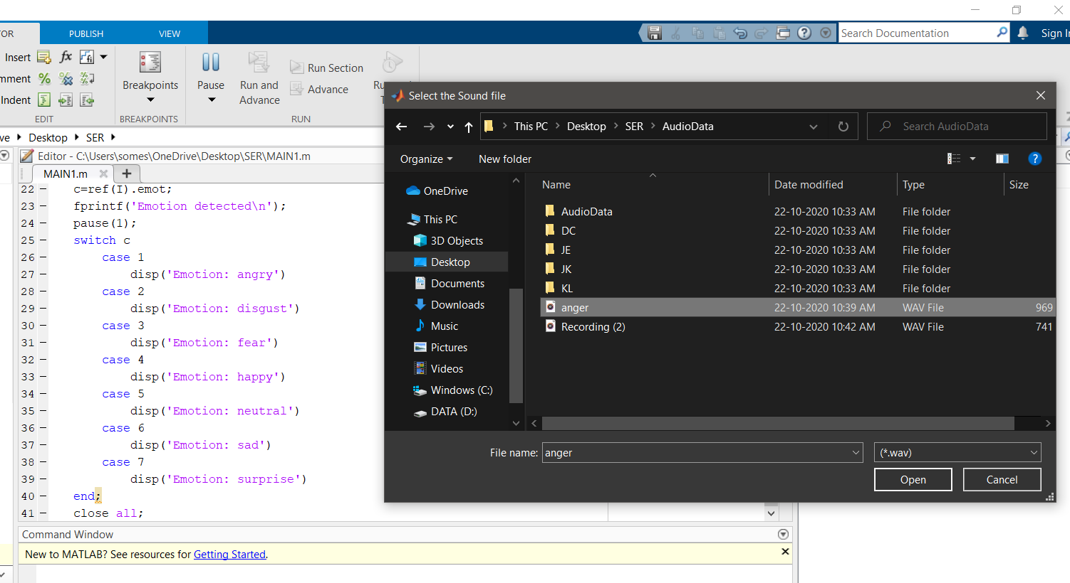
Modules Screenshot (Main app working)

Slide 9
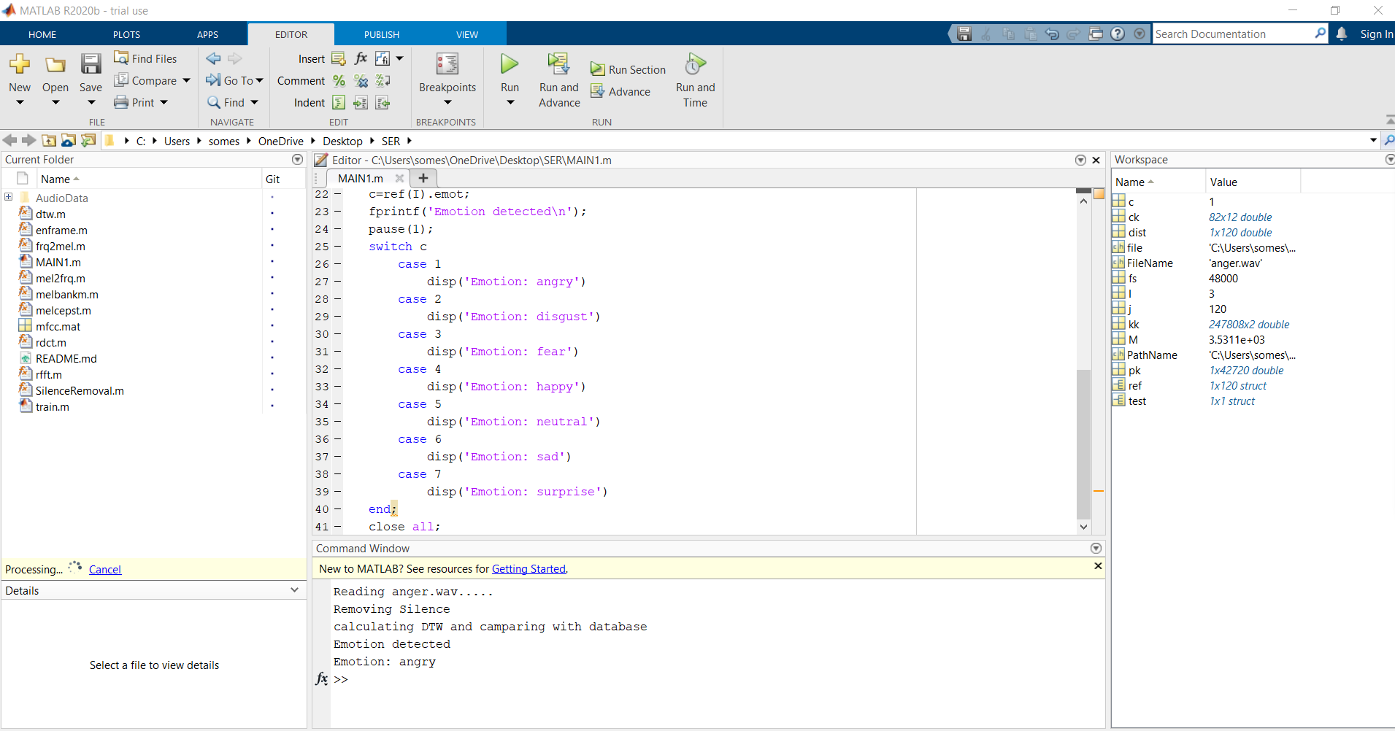
Main.m
It calculates distance between test sample and ref samples. After calculating distances, it assign label of minimum distance reference sample to test sample.

Slide 10
Conclusion
We have implemented Emotion Recognition from voice signals for six different emotions namely happy, sad, disgust, fear, anger, surprise and neutral from the English database. The feature extraction technique that we have used is Mel Frequency Cepstral Coefficient (MFCC).
Future Uses include automating evaluation of customer experience. AI decision making. Recognising distress etc.This model can be improved by using Hidden Markov Model (HMM) for further increasing the accuracy.

Slide 11
References
Voice RecognitionAlgorithmsusingMelFrequencyCepstralCoefficient(MFCC) and Dynamic Time Warping(DTW) Techniques, LindasalwaMuda, Mumtaj BegamandI. Elamvazuthi
http://www.ee.ic.ac.uk/hp/staff/dmb/voicebox/voicebox.html
http://wearables.cc.gatech.edu/paper_of_week/DTW_myths.pdf
https://www.psb.ugent.be/cbd/papers/gentxwarper/DTWalgorithm.html
http://www.phon.ox.ac.uk/jcoleman/old_SLP/Lecture_5/DTW_explanation.ht ml
http://www-db.deis.unibo.it/courses/SI-M/slides/04.5.TimeSeries2.pdf
https://www.vocal.com/speech-recognition
http://staffwww.dcs.shef.ac.uk/people/S.Wrigley/com326/sym.html
https://lemonzi.files.wordpress.com/2013/01/dtw.pdf
http://kahlan.eps.surrey.ac.uk/savee/
http://practicalcryptography.com/miscellaneous/machine-learning/guide- mel-frequency-cepstral-coefficients-mfccs/
Santosh Chapaneri , ”Spoken digits recognition using weighted MFCC and improved features for Dynamic time Warping” , International Journal of Computer Applications, vol.40,pp.975, Feb 2012.
http://in.mathworks.com/matlabcentral/fileexchange/24583-mirtoolbox

